Slide 1
ZOMATO EXPANSION ANALYSIS
By Neha Kumari
19-7-2024

Slide 2
About Zomato
Founded: By Deepinder Goyal and Pankaj Chaddah in India in year 2008.
Global Presence: It is now actively used in 24+ countries, with a strong focus on India, UAE, and Australia.
Sustainability Efforts: Initiatives to reduce plastic waste and promote eco-friendly practices.
Recent Developments: Expansion into grocery delivery and cloud kitchens, adapting to market trends has now increased chances of employment and engagement of the app and it’s services.

Slide 3
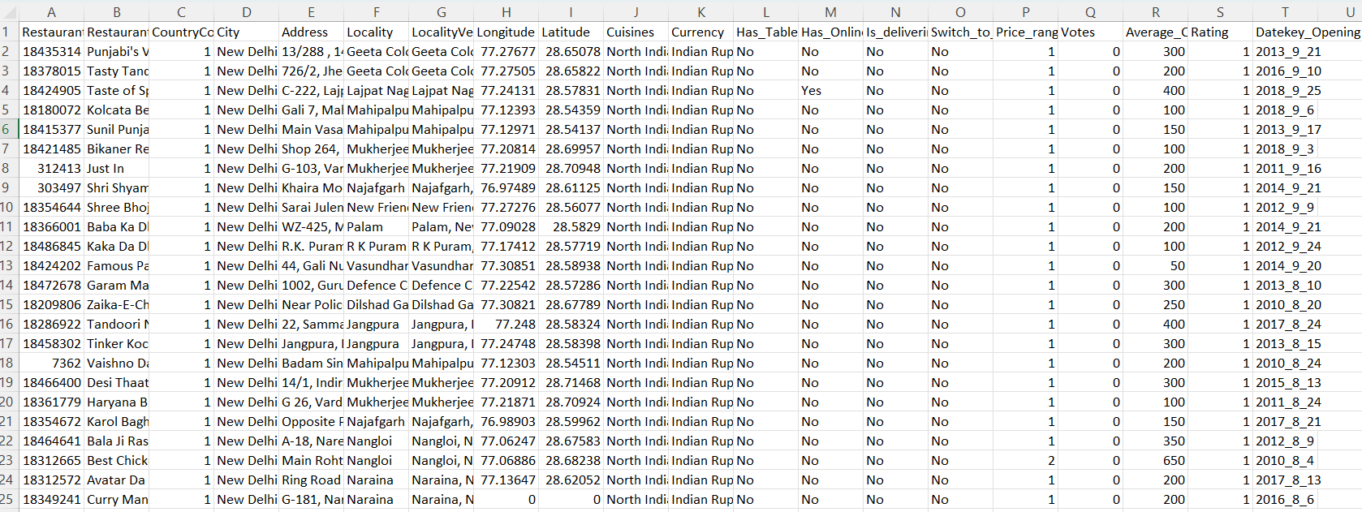
Problem Statement
I am a assigned as consultant data analyst by zomato where the team is looking for expansion and opening restaurants. My task is to come up with strategies/suggestions about opening newer restaurants.

Slide 4
DATASET OVERVIEW
Has_Online_delivery: Indicates whether the restaurant offers online delivery (Yes/No).
Is_delivering_now: Indicates whether the restaurant is currently delivering (Yes/No).
Switch_to_order_menu: Indicates whether users can switch to the order menu (Yes/No).
Price_range: A numeric value indicating the price range category of the restaurant.
Votes: The number of votes or ratings/(feedback) received by the restaurant.
Average_Cost_for_two: The average cost for two people dining at the restaurant.
Rating: The overall rating of the restaurant is based on user reviews.
Datekey_opening: The date when the restaurant was opened.
Average_cost_for_two(INR)- This show the average cost for two in indian currency.
Restaurant ID: Unique identifier for each restaurant.
Restaurant Name: The name of the restaurant.
CountryCode: Country code of the location where the restaurant is situated.
City: The city where the restaurant is located.
Address: The specific address of the restaurant.
Locality: The locality or neighbourhood where the restaurant is situated.
Locality Verbose: Detailed information about the locality.
Longitude: The geographical longitude coordinate of the restaurant.
Latitude: The geographical latitude coordinate of the restaurant.
Cuisines: The type of cuisine offered by the restaurant.
Currency: The currency used for transactions in the restaurant.
Has_Table_booking: Indicates whether the restaurant has a table booking option (Yes/No).

Slide 5
METHODOLOGY
Data cleaning involved removing blank values (5% of the data) and duplicates to ensure accuracy.
Data enrichment enhanced readability using VLOOKUP for filling missing details like date, price reference, conversion units, and country names.
Descriptive analysis was conducted using pivot tables and charts to visualize trends across ratings, votes, cuisines, and yearly openings, identifying key regions for expansion.
Customer preference analysis examined cuisine popularity by country and region based on average ratings and votes. Restaurant performance was evaluated using average cost for two and ratings.
Finally, dynamic dashboards with pivot charts and tables were created for an engaging and easy-to-understand presentation.

Slide 6
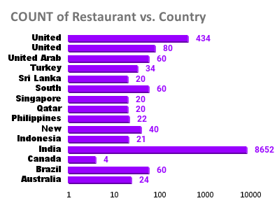
Country wise Restaurant Count
The analysis shows 9,551 restaurants in total, with India having the highest count (8,652), followed by the USA (434), the UK (80), and Canada (4).
This suggests that countries with a high number of restaurants are saturated, while markets with fewer establishments, like Canada, offer significant potential for expansion.

Slide 7
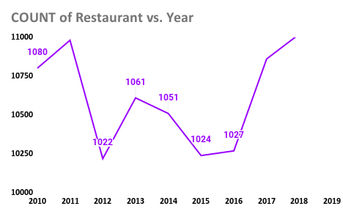
Year Wise Restaurant opened
The trend highlights a peak in restaurant openings in 2011, with 1,098 new establishments.
After a sharp decline in 2012, the market showed fluctuating growth, stabilizing with steady increases from 2015 onward.
A notable spike occurred in 2017, suggesting a continued upward trajectory.
This indicates sustained demand and a profitable market outlook in the coming years.

Slide 8
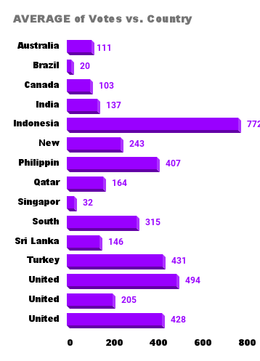
Average Votes Country wise
The votes are maximum for Indonesia 772 and min for Brazil 20.
There are country like India which have maximum restaurant count but low votes of 137.
This data analysis shows that the the votes are varying in spite of high restaurant count or low restaurant count the votes are not directly proportional.

Slide 9
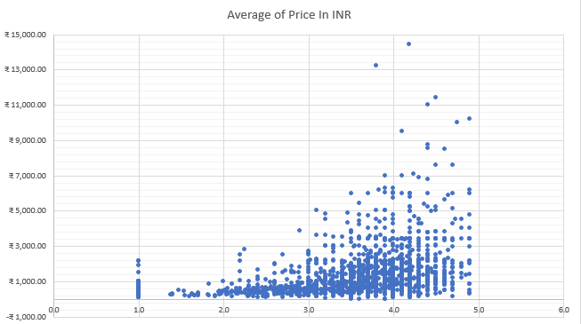
Correlation b/w Rating and Average Cost
The target countries are those with ratings between 3.1 and 4.0, a low restaurant count, and high votes. Based on these criteria, the recommended countries for expansion are Sri Lanka, Australia, Singapore, and Canada.
Additionally, a correlation of 0.334 indicates a positive relationship between the average cuisine rating and the average cost for two. While the correlation suggests a trend where higher ratings align with higher costs, the relationship is not very strong.

Slide 10
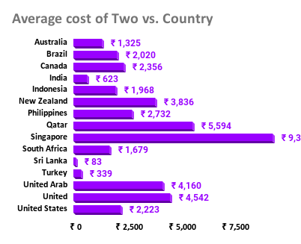
Expenditure
Average cost for Two in suggested countries range between Rs 83 to 9345.
It is also helping us narrow down our target cities by considering states that have high votes, high rating along with the average cost for two.
The preferred states in the suggested countries are
In Sri Lanka Colombo with average cost if Rs 83,
In Singapore Singapore itself with Rs 9345,
in Canada Vineland Station with Rs 4550 average cost and rating of 4.3 is most preferred as it will help in generating max revenue and
In Australia Palm Cove and Tanunda with highest rating and max cost of two.
These locations have least market saturation and high rating which gives us a better opportunity for the expansion

Slide 11
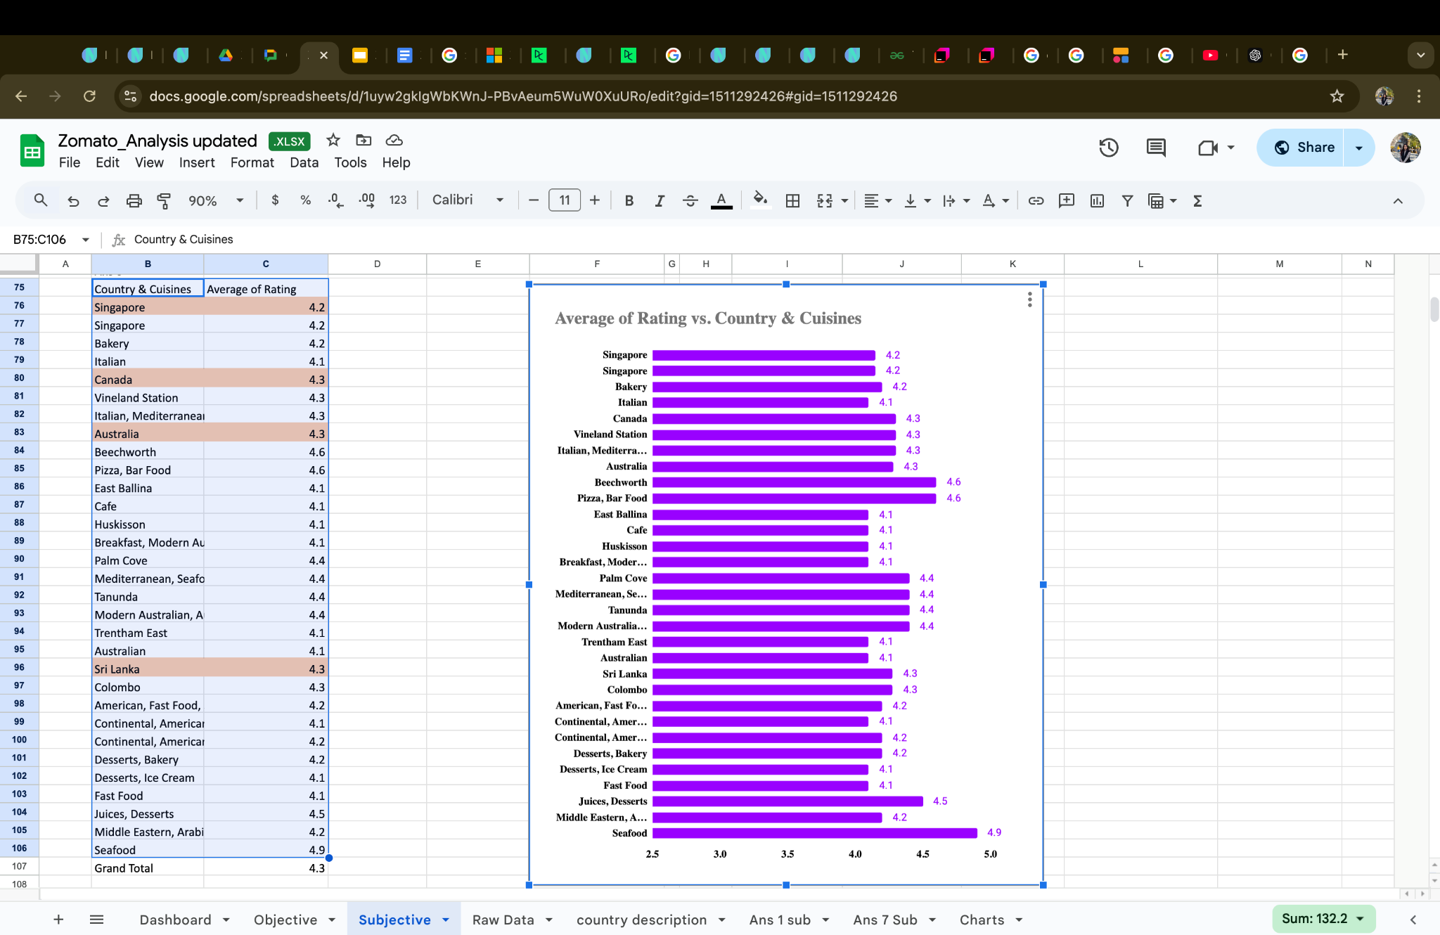
Cuisines
In the target cities, popular and highly rated cuisines include:
Singapore: Bakery, Italian
Canada: Italian, Mediterranean, Pizza
Australia: Pizza, Mediterranean, Seafood, Modern Australian
Sri Lanka: American, Fast Food, Steak, Beverage, Continental
The analysis shows that popular cuisines differ by location, so focusing on local favorites with high ratings will attract a larger customer base and drive business success.

Slide 12
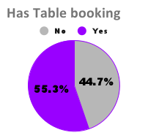
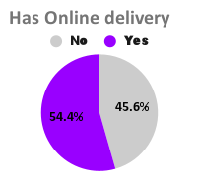
Online facilities
There are countries which offer online table booking and online delivery system which can be very helpful in establishing the market and we can also use these facilities in our target countries if it’s not there already.
Has Online table booking
Has online delivery

Slide 13
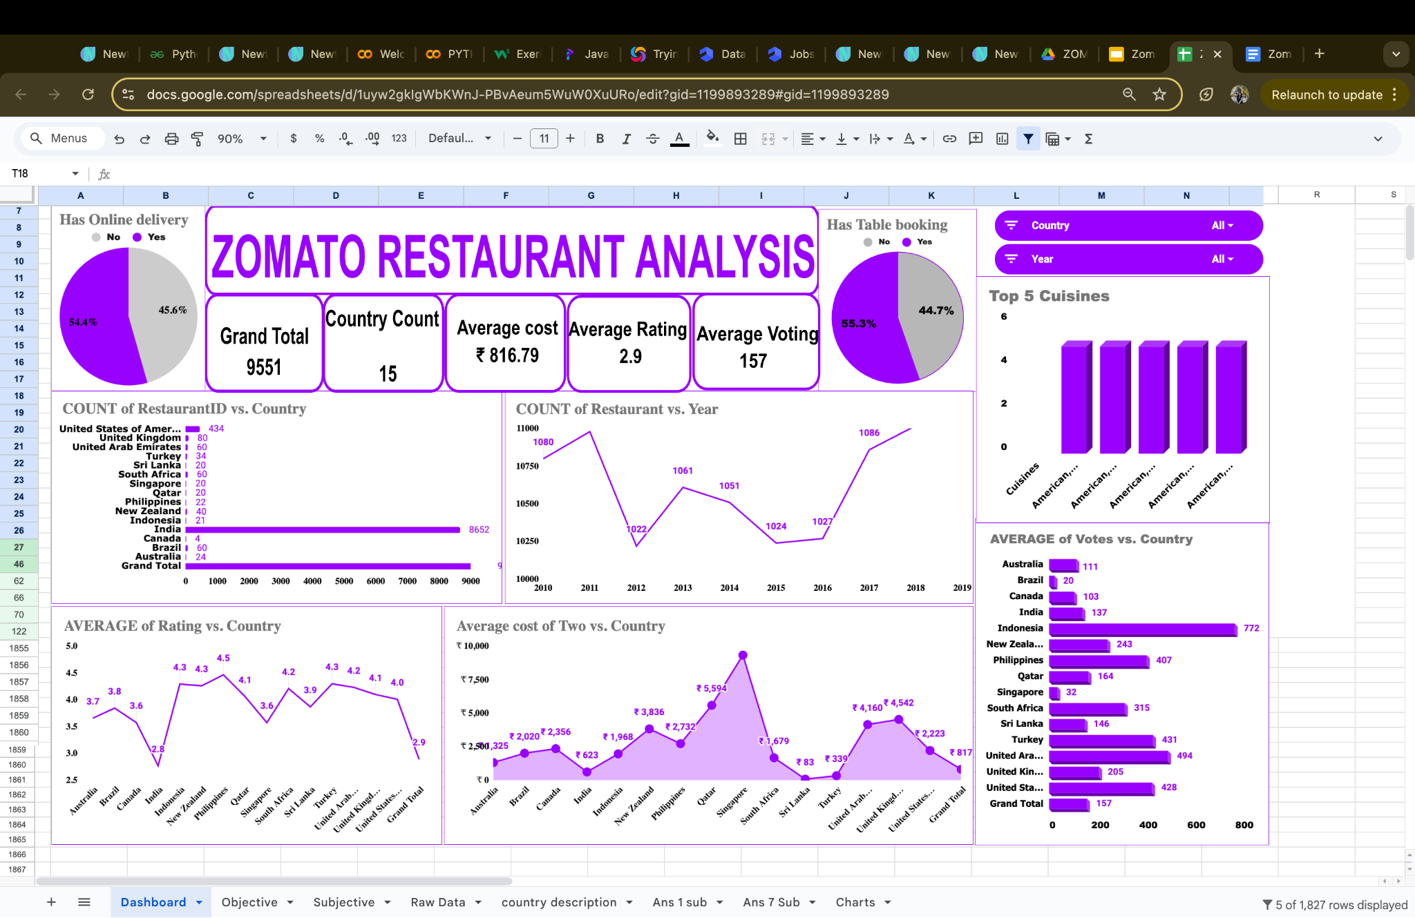
Dashboard

Slide 14
The Dashboard presents:
The boxes shows the count of restaurant, average rating and the count of countries, average votes.
Pie chart on left shows online delivery data and on right shows online table booking.
Chart one shows the total restaurant count in each country.
Chrt 2 shows the trend line for year wise restaurant opened.
The chart 3 shows the average cost for two in each country in INR.
The Chart 4 shows the country wise average rating.
Now chart 5 shows the average votes in each country.
The top 5 cuisines based on their ratings are shown in the last chart.
All of these charts are made dynamic using slicer for “country” and “Year” for better visualisation and analysis.

Slide 15
Recommendations
I recommend expanding restaurant operations in Sri Lanka, Singapore, Canada, and Australia due to their low restaurant count and average ratings between 3.5 and 4.0.
Among these countries most suitable cities are Colombo in Sri Lanka, Singapore in Singapore, Vineland Station in Canada,Palm Cove, Tanunda, East Ballina are best suited in Australia for opening restaurants.
Popular local cuisines that should be cuisine of interest in new restaurants.
Singapore: Italian and Bakery items are highly favored.
Canada: Italian and Pizza are the most popular choices.
Australia: Pizza and Mediterranean cuisine dominate.
Sri Lanka: American and Fast Food are the top preferences.
By aligning the menu with these local favorites while ensuring quality and consistency, restaurants can enhance customer satisfaction and improve ratings.

Slide 16
Conclusion
Customer Response- Analysed the customer rating their votes and their preference affecting the restaurant and cuisine.
New Market Penetration- The competitors has been identified and those restaurants which have lower rating are identified.
Pattern Analysis-The ides of price bracket is clear from the relation between the high rated restaurants and their cuisines.

Slide 17
Thank you

